Slide 1
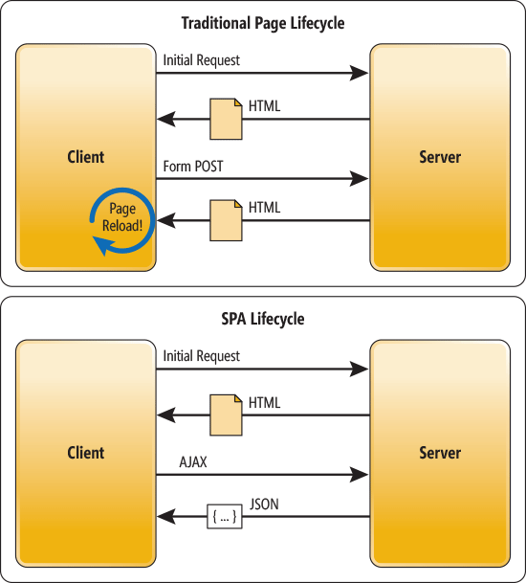
AngularJs + ASP.NET MVC
Hybrid SPA (Single Page Application)

Slide 3
Tools & Libraries
Nuget
AngularJS.Core
AngularJS.Route
bootstrap
jQuery
html5shiv
Respond
Bower
ng-table

Slide 4
Unit Testing
Javascript Unit Tests
Jasmine
angular-mocks
Resharper/Chutzpah + PhantomJS
Controller (MVC + Api) Unit Tests
structuremap
Repository Pattern + DI/IOC
Nunit
Moq
MvcContrib.TestHelper
Notes:
Javascript unit tests
Test Runner - Chutzpah
Install Vs extensions
Chutzpah Test Adapter for the Test Explorer
Chutzpah Test Runner Context Menu Extension
Test Runner – Resharper
Resharper > Options > Tools > Unit Testing > Javascript Tests
Verify Jasmine Support is enabled
Verify Jasmine Version – 2.0
Run Tests with PhantomJS – set the executable path (install phantomJs)

Slide 5
Next…
Real-time application using SignalR
Angular UI Bootstrap

